Slide 1

DAY 1: Theories and Principles

Slide 2
Other uses of find someone who:
– note it needs to be set up well to avoid odd questions
Grammar drill
FSW … has been learning English for over 6 years / has had their car for five years / has been on holiday for the last week, etc.
Collocations
FSW …has a brother / didn’t have breakfast / has time for a coffee after class / has had a baby recently, etc.
Word Meanings
FSW … what a rough area is / what demolish means / what the opposite of get rid of my car is, etc.
Word practice
FSW … has got rid of something recently / has heard about a murder in the news / is saving money for something, etc.

Slide 3
Tell each other about:
a successful teaching / learning experience
- where was it / what did you learn / how long did the “learning” last – has it changed or developed?
a failed teaching / learning experience
- what were you trying to learn? / In what way was it a failure? / Why?

Slide 4
Part 1:
Steps to learning
- What steps do you think are essential to learning a piece of language (a word / phrase / grammar item or rule?)
- Why do you think people learn languages?
- Why do they do it in class / pay a teacher?

Slide 5
HOW we learn
hear / see the item
understand the meaning of the item they are trying to learn
approximate the sounds of the item
pay attention to the item and notice its features
do something with the item - use it in some way
repeat these steps over time when encountering the item again in other contexts
Think about your last lesson. What did you teach what steps did you follow? What did you do?

Slide 6
What steps might each of these relate to? What’s else needs to happen to turn it into productive language?
- Learning lists of words
- Translating sentences back and forth.
- Learning grammar rules
- Doing drills

Slide 7
WHY we learn
to deal with the business of everyday life in another country, and to help foreigners staying in their own country to do so;
to exchange information and ideas with young people and adults who speak a different language and to communicate their thoughts and feelings to them;
to achieve a wider and deeper understanding of the way of life and forms of thought of other peoples and of their cultural heritage.
Which did your last lesson fulfill?
What aspects does your coursebook cover? How?
Are there any which are more important for you?

Slide 8
Why learn in class? / Why pay a teacher?
- provides discipline
- social
- motivation
- guidance on what’s right / wrong; what’s normal / not; what’s useful / not.
What are the implications of this?
How far do we fulfill these desires?

Slide 9
Part 2:
Where there’s more debate

Slide 10
Things to debate / variety in class and practice
what language to teach
the very nature of language itself
the order in which to teach the language we choose
the relative importance of each principle
the ways of fulfilling each principle of how to learn that language
whether we can actually teach and learn language - or whether it’s acquired.

Slide 11
1 Language is a list of grammar rules and vocabulary.
2 Grammar is the glue which holds language together.
3 Without grammar you can say little, without vocabulary you can say nothing.
4 It’s unimportant if examples are invented or unlikely to be used in real life if they clearly illustrate the meaning of the grammar.
5 We learn grammar by mastering one structure before moving on to the next.
6 Vocabulary should not be seen as single words, but as collocations and chunks.
7 If you teach grammar, students can learn words to slot into the grammar.
8 If you teach useful phrases first, it will help grammar develop.
9 How we experience and use vocabulary develops and shapes ‘correct’ grammar.
10 Students shouldn’t see grammar that they haven’t been taught yet.
11 You can’t separate grammar from vocabulary.

Slide 12
The language we teach / learn
How do these sentences relate to why we learn?
- No this is not a bank this is the Bolshoi Theatre.
- I bark, you bark, he barks
- You’re not going to go to Norway.
- Venus Williams is taller than Messi.
- Are you waving?
- I’ve only got one back.
- There’s a fat man sitting on a blanket playing the guitar.
- What is the Tour de France?

Slide 13
Why these examples occur in classes:
Grammar + words

Slide 14
Grammar and words - Building blocks
Elementary courses: first examples of –
went
been
going to

Slide 15
went p54
going to p90
been p110
This also impacts on choice of words and frequency. More on this on Wednesday.

Slide 16
Does grammar provide the building blocks of language? And what grammar?

Slide 17
see ages film want

Slide 18
I've been -ing
to + noun
that + noun
for + period of time

Slide 19
Grammar slots for any word?
I’ve been wanting to see that film for ages
I’ve been fancying to see that film for ages
I’ve been fancying seeing that film for ages
I’ve been anticipating seeing that film for ages

Slide 20
Pawley and Syder: native-like choices
It’s six less thirty.
It’s two thirds past five.
It’s forty past five.
It exceeds five by forty.
It’s a third to six.
It’s ten after half five.

Slide 21
There’s no pleasing some people.
There’s no angering some people.
It’s no satisfaction for some people.
Making some people pleased is impossible.
Some cannot be ensured happiness.
A few can gain no satisfaction.

Slide 22
a tall man
a high man
a tall building
a high building
a tall mountain
a high mountain

Slide 23
An alternative view of language and learning:
- words + words to grammar
- Lexical Priming (Michael Hoey)
result and consequence
cow, milk and field
scarlet onion

Slide 24
Nick Ellis. What does mandubled mean?
He mandubled across the floor.
Patterns established by very high frequency verbs.

Slide 26
1 Language is a list of grammar rules and vocabulary.
2 Grammar is the glue which holds language together.
3 Without grammar you can say little, without vocabulary you can say nothing.
4 It’s unimportant if examples are invented or unlikely to be used in real life if they clearly illustrate the meaning of the grammar.
5 We learn grammar by mastering one structure before moving on to the next.
6 Vocabulary should not be seen as single words, but as collocations and chunks.
7 If you teach grammar, students can learn words to slot into the grammar.
8 If you teach useful phrases first, it will help grammar develop.
9 How we experience and use vocabulary develops and shapes ‘correct’ grammar.
10 Students shouldn’t see grammar that they haven’t been taught yet.
11 You can’t really separate grammar from vocabulary.

Slide 27
A summary of a lexical view of language
words have more value than grammar
language is essentially lexically driven (words with grammar)
our usage is determined by our experience of how language is used
there are many patterns in lexis that are generative to at least some degree (including the traditional grammar patterns taught in ELT )
the vast majority of the examples of any one pattern will be made up of a small percentage of all the possible words that are used / possible
collocations and patterns will be primed to go with other collocations and patterns in similarly limited ways.
EVERYONE’S ENGLISH IS DIFFERENT!
How far do you agree?
What implications might there be for teaching and materials?

Slide 28
Some implications we’ll cover:
Increasing vocabulary input
Working from words to grammar
Providing examples of natural usage
Thinking more about frequency
Exposing students to more grammar
Exploring and exploiting collocations and chunks
What to correct and the way to do it

Slide 29
PART 3
A lexical view of vocabulary

Slide 30
Units of meaning rather than words
pull
table
card
out

Slide 31
pull out of the deal
pull out without looking
lay your cards on the table
lay your cards on a table
lay a card on the table
lay card on the table

Slide 32
Decide what the unit of meaning based on the word in red.
1 He’s applied for several jobs, but he he hasn’t found anything yet.
2 We were late because there had been a car crash on the motorway.
3 There’s no harm asking if you can go as well.
4 The weather’s been miserable for the last two weeks.
5 I had to queue for ages in the bank.
6 In the interview, she came across as confident and knowledgeable.
7 I usually take the dog for a walk in the evening.
8 Nothing goes better with spicy food than an ice cold drink.

Slide 33
Other aspects of word knowledge (or UoM knowledge!)
- collocation
- co-text (other words within a text)
- register (appropriate levels of formality or politeness) or genre (the kind of text the item will generally be used in)
- other words in a related lexical set (hyponyms)
- contextual opposites (antonyms)
- word form and related words within the same word family
- function and pragmatic use (how words in discourse can be used to do different things)
- connotation (negative or positive shades of meaning)
- synonyms (words of the same or similar meaning)
- colligation (grammar that goes with the word)
What might this be for these words / UoM?
have an argument
present an argument

Slide 34
Collocation (loose definition)
have an argument about it / him / something stupid / money / her spending so much time out
present an argument for a change (in the law) / a (adjective) approach / using the CEFR as a basis for course design
want to / need to present an argument
don’t want to have an argument.
have a terrible / furious argument
present a convincing / compelling argument
What questions could you ask Ss?

Slide 35
What verb goes with argument?
Who has an argument with whom?
What might a husband and wife have an argument about?
My friend Maria had a terrible argument with her boyfriend last night about his drinking.

Slide 36
Co-text
have an argument
What about? / She phoned me / She was really upset / calm down / came round to my house / crying / floods of tears /screaming at each other.
alcoholic / out of control / drunk, etc.
present an argument
suggest, go on, question, show, conclude, etc.

Slide 37
How might you feel if you have an argument?
And when you have an argument, what might you do?
And what might happen afterwards?
What might you say - or ask - if someone tells you that they had an argument with their boyfriend last night?

Slide 38
Register and genre
Have an argument
spoken texts (compare with row / barney)
Present an argument
academic writing / presentations
BUT not strong variation and NO questions – they don’t always work

Slide 39
Lexical sets
car / motorbike / van / lorry …
cat / dog / giraffe / elephant / aardvark …
Have an argument
chat / talk / gossip / exchange /discussion / laugh / disagreement / row / conflab
Present an argument
suggestion / explanation / advice / opinion / apology
What other kinds of talk can you think of?

Slide 40
Opposites
have an argument have a chat / have a laugh
present an argument challenge / respond to an argument
have a terrible argument have a little argument / a slight disagreement
present a compelling argument present a weak / unconvincing argument
What’s the question?

Slide 41
Word families
Have an argument
argue /argumentative.
they’re always arguing / they never argue / they argue a lot.
Present an argument
argue / arguable / arguably
he argues that … / he goes on to argue …/ it is argued that...
Notice the colligation – cont / passive

Slide 42
Pragmatics / function
Have an argument
A: They’re having an argument.
B: I’ll come back later.
What other replies?

Slide 43
Synonyms
Have an argument
have a row (centre of a growing row)
tear strips off each other
present an argument
put forward a theory
Why might you want to avoid asking “what’s another way of saying have an argument?”?

Slide 44
Explanations
What does grasp mean?
A It’s this: mimes grasping a bag
B Seize, clutch.
C If you grasp something you take it and hold it firmly.
D You grasp someone’s arm, or you grasp a rope or grasp a bag like this [demonstrate] tightly.
E Translates into students language
F Grasp? What was the sentence? What did they say?

Slide 45
The grammar is difficult to grasp. What does grasp mean?
A grasp means comprehend.
B Because the grammar is very complicated – there are lots of rules – it’s hard to
grasp – it’s difficult to understand.
C Translates grasp into students language
D it means it’s difficult to comprehend – to understand fully. So you often look back and realise you didn’t fully understand something. For example:
I knew the changes were big, but I didn’t grasp how much they’d affect me.
I didn’t grasp how serious the illness was
I didn’t grasp the importance of planning.
I didn’t grasp the significance of the decision at the time.
E It means XXX [translates] For example:
I knew the changes were big, but I didn’t grasp how much they’d affect me.
I didn’t grasp how serious the illness was
I didn’t grasp the significance of the decision at the time.
I dn’t grasp the importance of planning.

Slide 46
How might you improve the way the meaning is conveyed?
A a whale
“It’s like a big fish, like a big dolphin. It’s in the sea. It jumps out of the sea. You know Moby Dick, the book. Moby Dick was a whale. Very big. Woosh! Woosh! [mimes water blowing out of their back].
B do up
“it means refurbish”
C rush
“If you rush you run you do it quickly”. T acts out “rushing” by running to the door.
D portion
“if you had a pizza and divided it into 4 – you have a portion for each person”
E make
‘hacer’ in Spanish
F He was screaming in agony
“He was crying loudly because it hurt a lot”.

Slide 47
Think of examples of the words / phrase.
When would you say it? Why? Who to?

Slide 48
Part 4: A lexical view of grammar
Normal grammar patterns
Shifting from tense grammar - more grammar not less!
Chunks and working with frequent words
Discourse – vertical and horizontal development
Grammar terms

Slide 49
Normal grammar just better examples!!
- No this is not a bank this is the Bolshoi Theatre.
Is there a bank near here?
- I bark, you bark, he barks
There was a dog barking outside all night.
I wish someone would stop that dog barking.
- You’re not going to go to Norway.
I’m not going (to go) in the end. I couldn’t get a visa.
- Venus Williams is taller than Messi.
The situation here is better than before.
- Are you waving?
Are you coming?
Are you listening to this?
- I’ve only got one back.
I’ve done something to my back. / My back hurts
- There’s a fat man sitting on a blanket playing the guitar.
What do think of it?
> It’s nice.
- What is the Tour de France?
Have you been watching the Tour?
Who do you think is going to win the Tour?

Slide 50
What does grammar mean?! What are we teaching?
Past tense
Continuous forms
Perfect forms
Yes, I do / No, I don’t
Countable / uncountable
How much time on noun phrases? On patterns and discourse?

Slide 51
Chunks
Have you been to Paris?
Is this an example of present perfect or Have you been to + place?

Slide 52
Examples and highlighting patterns.
We often can help students speak more fluently by showing ‘chunks’ of language or patterns in sentences. Tenses are a kind of pattern but there are many more around words or that ‘frame’ sentences. For example:
Sorry. I’m in a rush.
Do you fancy a coffee
a cigarette?
doing something later?
going out for lunch?
Just because I’m English doesn’t mean I’m cold and unfriendly. (sentence frame)

Slide 53
Can you see any chunks or patterns in these sentences and exchanges?
1 I stayed in and watched the latest episode of Mad Men.
2 Learning to manage a budget may be boring, but it’s essential.
3 I didn’t expect it to be so polluted.
4 More and more people are working longer hours.
5 I’m going to run a marathon.
> Really? Rather you than me!

Slide 54
Can you see any chunks or patterns in these sentences and exchanges?
1 I stayed in and watched the latest episode of Mad Men.
2 Learning to manage a budget may be boring, but it’s essential.
3 I didn’t expect it to be so polluted.
4 More and more people are working longer hours.
5 I’m going to run a marathon.
> Really? Rather you than me!
‘Horizontal’ and ‘vertical’ development

Slide 55
Vertical
Thinking how one simple conversation develops (question / answer / question answer)
A: I’m pregnant.
B: That’s great. When’s it due?
A: June.
B: Do you know if it’s a boy or a girl?
A: It’s a girl.
B: have you chosen a name?

Slide 56
Horizontal
Different variations of chunks
Have you been to France / Spain / Yaroslavl?
Varieties of answer to same question
No never
Yes – It’s great.
Yes - I went last year?
No – I’ve never really fancied it
No – but it’s supposed to be great.
Follow-up comments to the same answer / function
I’m really sorry. I’ll get a cloth
I’ll clean it up
I’ll buy another one.
I’ll pay for the damage

Slide 57
1 We’re going to get married.
2 Are you OK? You look a bit tired.
3 Did you see the game last night?

Slide 58
ANY QUESTIONS?

Slide 59
Part 5: options and approaches
Discuss the beliefs on the sheet

Slide 60
How many of these have you heard of?
Which beliefs might be associated with each?
Grammar Translation
Direct Methods / Audiolingualism
Functional-notional / CLT and PPP
Silent Way
Task-based Learning
Natural Method / Extensive Reading
Dogme
Lexical Approach

Slide 61
hear / see the item
understand the meaning of the item they are trying to learn
approximate the sounds of the item
pay attention to the item and notice its features
do something with the item - use it in some way
repeat these steps over time when encountering the item again in other contexts

Slide 62
My beliefs
Any Questions?

Slide 63
Day 2
Level, input and expectations

Slide 64
How did you learn about what different levels means and judging what level students are? How do you define level?
Do you get students who you feel are in the wrong level? What happens to them? Are they new or continuing students? Can you move them?
How is level decided in your school? How are students placed? What is good/bad about this process?
How do you deal with different levels within the class?

Slide 65
Defining level and input
- ‘difficulty’ of concepts and building blocks
- ‘ease’ of teaching – vocab sets / single words
- frequency – are you any good?
- performance / can do statements
- what they want to do!

Slide 66
Top 100 get have been long said were is tell go | Top 1000 pass provide book chair (n) contain small economy test (n) bus red list (n) serious sort (n / v) | Top 2500 meat countryside mood insist sad failure fun recommend list (v) relief policy coal gold | Top 5000 clay silk undermine component exam apple cinema lamp poster carbon allegation pleased upset bored short term medium relieve potato sue | Top 7500 chair (v) banana purple garlic kind (adj) curly blonde thriller romance tan bad-tempered | Over 7500 pear yoga chilli medium-sized skinny moody sunburnt electrician civil servant salmon

Slide 67
How many words do we need?
Text coverage Vocabulary size
50% 100
72% 1000
80% 2000
90% 6000
97% 15000 (academic texts)

Slide 68
School levels and coursebooks – the lies we tell!
90 x 6 = 540hrs = C2
540 ÷ 20/week = 27 weeks or 6 months!
Double it with homework = C2 in a year
A2 + 70 + some workbook exercises + enthusiasm +
success in grammar manipulation = B1

Slide 69
Defining level by grammar: low levels
Students can have a lot of latent grammar knowledge at low levels.
see, saw, seen
KET / A2 / Elementary
making arrangements, making, agreeing to and rejecting suggestions, stories etc.
= going to / past continuous / pres perfect modals
Restricting grammar can restrict developing competences.
no reference to grammar in global scales of CEFR

Slide 70
CEFR: syllabus and grammar
The inherent complexity [of a grammar structure] is not the only ordering principle to be considered [in developing a course].
The communicative yield of grammatical categories has to be taken into account, i.e. their role as exponents of general notions. For instance, should learners follow a progression which leaves them unable, after two years of study, to speak of past experience?
Authentic discourse and written text may to some extent be graded for grammatical difficulty, but are likely to present a learner with new structures and perhaps categories, which adept learners may acquire for active use before others nominally more basic.
Council of Europe 2001, Common European Framework of reference for languages: leraning, teaching, assessment, CUP p151

Slide 71
Defining level by grammar or idiomaticity: High levels
Continued focus on tense grammar + skills.
Doing a skills activity is not teaching.
Receptive skills primarily require lexis.
Can read with a large degree of independence adapting style and speed of reading to different texts and purposes and using appropriate reference sources selectively. Has a broad active reading vocabulary, but may experience difficulty with low frequency idioms.
Single word focus either too easy – AWL – or too infrequent
Idioms often low frequency

Slide 72
Solutions for mixed levels 1
Teach some complex grammar as vocabulary.
Core easier language tested, but extra to notice.
Give students opportunity to express real opinions.
Explore usage of ‘known’ words. Level as deeper knowledge
Fuller examples cater for a wider range of level.
Use Ss output to teach for and beyond ‘their level’.

Slide 73
Grammar as words / phrases at low levels
Have you been to Brighton?
Can you help me?
I'll be there in 10 minutes.
Maybe we should go now.
I must buy some water.
I have to go to the bank.
Where / what time shall we meet?
We could ask, if you want.
If you want to go shopping, I'd go / I wouldn't go to Oxford street.

Slide 74
Core easier tested but extra to notice
How much is it?
What time shall we meet?
When does it start?
What time does your flight leave?
What time do we have to be at the airport?
So what time (do you think) we should leave here?
How long will you be?
How far is it?
How old is he?
How many people were there?
How many people are unemployed?
How long have you been here?
What's the average wage?
age people leave home?
age people get married?
age people retire? (1000-2000) any other ideas (die)

Slide 75
Opinions
The US government is bad. They don't do anything.
His new flat is good. It's big.
My son's school is OK. He's happy there.
Our science teacher is good. She explains things well.
The food here is bad. It doesn't taste nice.
The area near the station is bad. There's a lot of crime.
This coffee is good. It's nice and strong.
The French economy is bad. There's a lot of unemployment.
That French restaurant is OK. The food's nice, but it's expensive.
The government
His flat
My school good
Our teacher is OK
The food bad
The area
This
The economy
That restaurant
In general we not only underestimate the frequency of 'serious' words but also the interests and abilities of low level learners

Slide 76
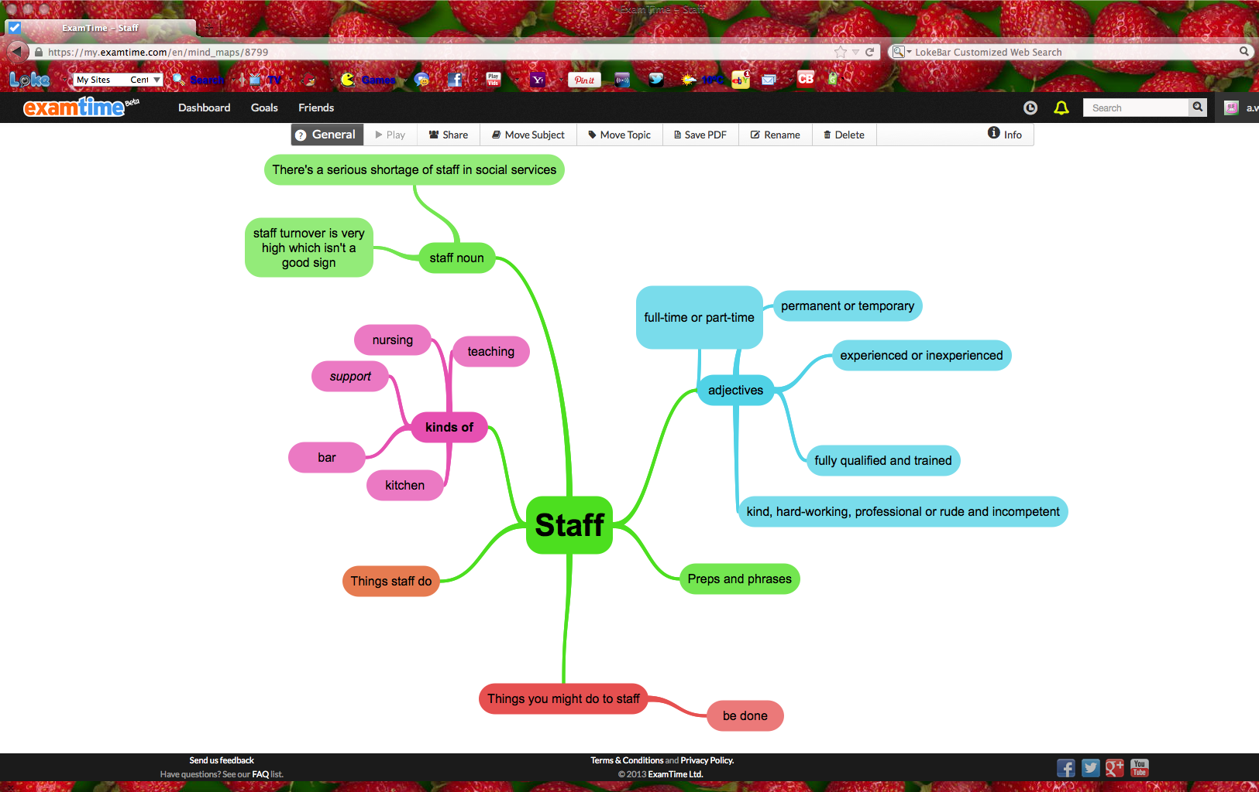
Usage of known words
staff: exploring collocations
recession: exploring co-text
When there's a recession what happens?
- unemployment goes up / soars*
- people lose their jobs / get made redundant*
- companies close / go bankrupt*
- the government (everyone) makes cuts
- sell the car / get rid of any luxuries*
- get into debt
- lose their house / get repossessed*
- have difficulties / struggle*
- don't spend money / people tighten their belts*

Slide 77
Exploring known words and fuller examples
The apartment will be available on June first
Your continued lateness for class indicates to me that you are not really a very serious student.
The young popstar became famous while still in high school after winning a contract with a major record label.
The determination of the readily available phosphorus of soils
The information available in brief visual presentations.
Rate of cell death in parkinsonism indicates active neuropathological process
Native American mitochondrial DNA analysis indicates that the Amerind and the Nadene populations were founded by two independent migrations.
Trust and breach of the psychological contract
Contract enforceability and economic institutions in early trade: The Maghribi traders' coalition

Slide 78
Fuller examples of low frequency vocabulary
When the ambulance arrived he'd stopped breathing, but the paramedics got his heart going again before they rushed him to hospital.
Our little boy has been ill a lot, but our doctor isn't sure why, so he's been referred to a paediatrician.
There's been a scandal because the nurses were found to be neglecting patients. Some had even died because of the lack of care.
The nurse said the surgeon's very good, so I'll be in safe hands when they operate.
The surgeon said the operation had gone well and he expects him to recover well.
What's happening?
>I'm waiting for the nurse to take some blood.

Slide 79
Using student output
Have you heard of anyone who needed a paramedic? Why what happened?
Do you know anyone who's had a referral?
Who to? What for?
Have you ever had to consult someone? What about?
Have you heard of any cases of neglect? What of? What happened?
Have you heard of any scandals? What happened?
Some more examples to come!

Slide 80
Part 2
Dialogue building – working with grammar chunks and using students to get meanings

Slide 81
What stages did we go through in the dialogue building?

Slide 82
Dialogue building
Write out / Plan dialogue you want to do!
Establish situation / starter sentence. Say it. Translate it.
Get students to repeat it chorally and individually (Drill).
As students repeat individually, correct pron and / or reply.
Write Starter sentence on the board.
Elicit response(s). Help by translating, if necessary. And write on the board.
Drill responses and / or elicit responses with starter sentence and vary starter sentence (if possible). Translate variations if unclear.
Get students to do first part in pairs.
Start the conversation with different individuals and continue it to third line.
Elicit third line (pointing to the board). Drill. (Write on the board)
Students practice in pairs.
Repeat previous stages as long as you want or with variations you want.
Finally, get students to repeat wiping off what’s written on the board in stages .
Revise the Following day!!!

Slide 83
What similarities did you see between the dialogue building and the feedback to the warmers earlier?
What might dialogue building tell you about some of my beliefs about language and learning?
What objections might there be to learning in this way?

Slide 84
Dialogue building and correction
Look at the ‘errors’ where conversations breakdown rather than just grammar they got wrong. It’s often what they don’t know yet.
Think what is the natural thing to say after ‘yes / no’? What’s the question you would typically ask next? What might be the reply? How might they say it more naturally / colloquially.
Show students on the board. Elicit their ideas and help through judicious translation.
Drill new language. (something I often forget to do!)
Get students to repeat what they did with the new language (maybe with new partner).
Get them to remember it / test each other in some way.
Revise it at some point (a good coursebook will help!)

Slide 85
DB and beliefs about language and learning
It’s outcomes focused. What might you want to say / write?
We can learn ‘grammar’ which is above our level in phrases.
We don’t have to learn about all the rules straightaway.
Students have a huge resource of language and how conversations work – in their own language
Translation has an ESSENTIAL but MINOR role in the lesson.

Slide 86
Part 3:
Two approaches to vocab and collocation

Slide 87
What did you learn from the experience?
What levels?
When do it?
Teach some verbs and phrases with TPR

Slide 88
Part 4:
Using students’ talk to teach vocab and grammar

Slide 89
Scar stories: Modelling speaking and longer turns
We can use a similar kind of technique to present vocab and grammar through stories / anecdotes / ‘explanations’.
These work best with particular genres or types which will share a lot of features and vocabulary.

Slide 90
What stages did we go through in the scar stories?

Slide 91
Write down the ‘story’ and think about the key language you’ll write down. ideally plan your board (something I often fail to do!)
Tell your story and as you do write down key words and phrases (translate judiciously and use mime too)
Ask if a student will tell their story – nominate a stronger one if necessary.
You might point to the existing language or structure on the board to help the student.
You may also let them say words in L1 and translate and / or write up new words they use on the board
Repeat with one more student.
Get Ss in pairs to tell their story – and LISTEN and HELP.
Re-tell one or more of the stories you heard. Add more language on the board OR correct an aspect of vocab usage / grammar / story structure
Get Ss to repeat with new pair
Feedback (perhaps on a new area)
Repeat with new partner

Slide 92
Scar stories: how it helps with speaking
Directs you to language Ss actually need rather than grammar rules + words
Makes use of students real lives – better hook for teaching and memory
Creates rapport and bonds between T and Ss.
The same can be done to model and correct ANY speaking in the class (even where you don’t necessarily write up language)
Model also provides a guide to what you expect students to do and feedback on how they can improve (see criteria later in the week).
Repetition is not necessarily boring! (new partners / new language)
Could be done as a roleplay in L1 first!

Slide 93
Scar stories and ‘error’ correction
Looking not just at surface grammar but how to help them say what they want to say.
Re-doing tasks may help re-focus on language use.

Slide 94
Part 5:
Practice
ESP

Slide 95
Exploiting first day chat
How's it going?
Cheers.
Whereabouts?
You won't know it. It's …….. .
Are you from here ………… ?
I ……… to live there.
That sounds high-powered.
That must be good.
Me too/So ….. I.
How long have you ……. doing that?
> Ages
> 3 years on and …… .

Slide 96
What did you do at the weekend?

Slide 97
Choose one to do a dialogue build
I went shopping … clothes / things / compliments
I went to see my gran / sister family / questions
I was in bed all weekend illness vocab / sympathy / advice
I went to the cinema types of film / film questions / adj's
I went to X. What's it like? / what did you think of it?
I watched the X match football vocab / opinion (should've)
I played X … how often? How long?
I was going to… but weather / changed plans
I had to … obligation / work
I spent Saturday in A nd E narrative tenses / accident vocab / must've been

Slide 98
Choose one of the following for a scar story.
last film I saw
my weekend
a problem at work
applying for a visa
my son / daughter’s school
OR something else?

Slide 99
ESP
There may be some ‘grammar’ that differentiates certain genres – e.g Academic English / teaching – but not the main issue.
What distinguishes Business English / Academic English / Nurse’s English etc. is largely vocabulary and it’s frequency.
It’s more likely to be needs driven and doing the task they need to do is probably the best starting point. Feed in the language. Develop and repeat in follow-up lessons. Maybe develop and make use of new vocab.

Slide 100
Day 3
More than just the answers
Exploiting vocabulary exercises

Slide 101
Part 1
Setting up tasks
How vocab exercises work
To pre-teach or not

Slide 102
What do you normally do to set up a vocab task? Choose one of the tasks and present and do it to your partner as the teacher.

Slide 103
I would normally:
Say what the task is about
Say what they have to do
Do the first example with the class
Get them to do it
Get them to compare once they’d had a go and finish
Go through the answers.

Slide 104
To pre-teach or not to pre-teach
No
Most vocab exercises include some words students will know. The task is there to find out what they know / don’t know.
They can use a dictionary and help each other (mixed ability) to complete the task.
You can notice what to spend more time on.

Slide 105
YES
Helps students do the exeercise and check their understanding.
Two alternatives to going through them all.
1) Mark what know / think you know / don’t know.
2) Read out the translations quickly Ss note what they don’t know / collaborate.

Slide 106
All vocab exercises will focus on one or more aspect of word knowledge but may leave out other aspects.
Teacher will want to deal with this lack in feedback.

Slide 107
What aspects of knowing a word do you remember?

Slide 108
Look at the tasks. Decide:
what aspect of word knowledge is touched on.
what you might want to add in feedback.

Slide 109
Part 2
Going through the answers
Asking questions
Exploiting patterns

Slide 110
Traditional concept checking questions about grammar that I learned when I was training. Maybe useful to focus students on meaning of grammar see if they understood explanation.
Is it now or the past?
Isi t real or unreal? / Happen or not?
Good idea or bad?
Choice or not?
Is it finished or unfinished?
Likely or unlikely?

Slide 111
Concept Checking Questions applied to lexis
to shlock
Does this mean I eat / drink a lot or a little?
Does it mean I do it in a short time?

Slide 112
I was driving too quickly. A policeman stopped me. I had to trad a krat.
Did I give the policeman money?

Slide 113
I was driving too quickly. A policeman stopped me. I had to trad a krat of 80 Euro.
Does this mean I gave the policeman money?
Why did I give him the money?
Does the policeman keep the money or the government?

Slide 114
go hossky means to go on strike.
So if you go hossky, ….
- are you happy or unhappy about your job?
- do you go to work?
- Is it a holiday? Do you get paid?
- Do you want something about your job to change?

Slide 115
How much feedback do these CCQs provide?
Can we extend students' based on this feedback?
LET'S look at some alternative kinds of Qs.

Slide 116
Have you ever gone hossky?

Slide 117
Who's hossky now?

Slide 118
Why might people go hossky?

Slide 119
What do you have to do to hossky?
How does it end?

Slide 120
Traditional concept checking questions are
not designed for vocabulary.
- generally no 'concept' but complex meaning!
- meaning and usage too multifaceted and slippery
- cultural issues may mean a yes / no 'display' is wrong!

Slide 121
Principle:
meaning is a small part of knowing a word
Good vocab checking questions:
- usually include the key word(s) in the question
- impersonal and based on might and prototypes
- explore what it is to know a word
- are open and/or generate connected language
- may have unexpected answers – not exactly display
- provide feedback that allows to extend learning

Slide 122
What aspects of knowing a word do you remember?

Slide 123
What aspects of word knowledge are being looked at through these questions?
What other things can you binge on?
What's the opposite of leave halfway through?
What do people do if they are angry?
What might you say if you were pleased with something?
What might you ask if it's boiling in a room?
What preposition follows interested?
Why might someone avoid a rough area?
What else might people avoid doing?
What form follows avoid?
What kind of buildings are usually described as grand?
What's an easier way of saying contends that?

Slide 124
Look at the items of vocabulary in bold below – and at the examples in italics that were written on the board by the teacher after asking connected questions about each item. Decide which questions were asked to produce each example.
1 He’s very fit. He does a lot of sport and he goes running twice a week.
I’m really unfit at the moment. I get out of breath just walking upstairs.
2 It was the toughest decision I’ve ever had to make.
I’m so indecisive. I can never make up my mind what to buy or wear!
3 I took out a loan to buy a horse for my daughter.
I’m still paying off my mortgage. I’ve got twelve more years to go.
4 He was kicked out of the team because he was always late for training.
He was kicked out of the house after his wife found out he’d been cheating on her!

Slide 125
Take one of the exercises and write questions for the vocabulary.

Slide 126
Patterns and grammar
As we saw on Monday there are also chunks and patterns you may be able to exploit.
They won’t necessarily be in every example, but can you find any? Can you show how they might be varied?
Are there any examples of traditional grammar / tense you could draw attention to? What questions might you ask?

Slide 127
Part 3
Going through the answers – single words and collocation
Giving better examples

Slide 128
Better examples – exploring collocation
ambitious
adv - adj
adj - noun

Slide 129
Collocation of collocation
adv: extremely, hugely, overly, too, wildly, ruthlessly, artistically, politically, socially
noun: attempt, plan, programme, proposal, venture, aim, goal, target
adv - adj – noun an rutlessly ambitious politician
adj - noun – verb the ambitious plan failed
verb -adj – noun put forward an ambitious plan
noun - verb - adj – noun

Slide 130
The government has put forward an ambitious plan to end poverty for children.
Do the same for words in exercise 1-4

Slide 131
Collocations to experience to example
efficient service

Slide 132
The other day, I went to a government office to register as a self-employed person and I expected it to take ages, but in fact they were really efficient. I was given a ticket and told to wait in a queue, but I only had to wait ten minutes and then the registration took five minutes. It was great.
Shorten this to an example for the board.

Slide 133
I went to a government office to get a new passport. It was a really efficient service - it only took one hour!

Slide 134
Try with these or with examples from the exercises.
give a hand a bunch of flowers
go on a diet a training course
waste money feel guilty

Slide 135
Examples as dialogues
why would you say it? who to? What would they reply?
lose the match
take notes

Slide 136
How did the match go?
> Oh we lost.
Did you go to the class yesterday?
> Yeah. I took some notes. Do you want to copy them?

Slide 137
1 restore an old motorbike
2 core business
3 economy
4 efficient
OR take examples from the exercises 1 – 4.

Slide 138
Look at the examples you came up with.
Can you think of a follow-up question or highlight any patterns or other collocations?

Slide 139
Part 4
Other exploitations of vocab exercises.
Practising vocab

Slide 140
Memorize and test tasks
Question-answer.
Verb and collocates (or whatever!).
Sentence and comment.
Write the first letters for your partner
Two-way translation
- for meaning
- to remember word order / etc.

Slide 141
Notice new language
Underline new collocations or phrases
Compare what you chose
DO any of the things you did in last section – ask them to find a collocate
– write your CCQs for students to answer

Slide 142
Personalise vocabulary
Write something true about:
- yourself
- your family
- your country
- your work
- a news story
Choose one of the exercises to do this. Always easy?

Slide 143
Questions
Do you know anyone who has gone hossky? Why? What happened? Were they successful?
Have you ever left halfway through something? What were you doing? Why did you leave?
Is binge drinking a problem in your country? Why / Why not?
Are you avoiding anything or anyone at the moment? What? Why?
Do you know any rough areas? Where are they? Why do you think they're rough? Do you know any that used to be rough?

Slide 144
Questions including key vocab are fine
Be prepared to teach surrounding language
Frame questions appropriate to student's experience
Allow for reference to people as well as 'me'.
Ask a variety of questions about a variety of vocab
Don’t expect all questions to be ‘successful’!

Slide 145
Practice
Choose one exercise.
Write 5 or 6 questions to practise vocab.
Get a partner to answer them.
Which work? Which don’t? Why?
What other language do they generate?

Slide 146
Tell a story based on a word (scar story)
I got robbed on holiday

Slide 147
I was sitting outside a cafe and I had my bag on the table and this guy came up to me and started talking to me in a foreign language and pointing to a map. He then walked off and I suddenly realised he’d grabbed my bag. I was going to go after him but he’d gone. My bag had my phone, passport, purse, everything in it.

Slide 148
Messaging: George Woolard
Text
Translate
Identify chunks
Vary chunks
Use dictionary / teacher
Create a new text
Memorise / Practice

Slide 149
I was sitting outside a cafe
I was sitting on a bench in the park
I was sitting in the main square
I was standing at the bus stop
I was walking down the street
and I had my bag on the table
and I had my bag next to me
and I had my bag over my shoulder
and I had my phone on the table
and I had my wallet on the table

Slide 150
his guy came up to me
this girl came up to me
this man walked up to me
this woman ran up to me
this guy rode up to me on a bike
and started talking to me
and started shouting at me
and started pointing to a map
and started asking for directions
and started asking me for money

Slide 151
What language comes out of this story?
Our house was robbed

Slide 152
Part 5
Sample lesson

Slide 153
ANY QUESTIONS?

Slide 154
Day 4 – Reading
part 1 – skills and texts

Slide 155
What’s your favourite text for use in the classroom? Why?
What do you normally get Ss to do before, during, after they read?
What do you as a teacher do?
In real life, when do you talk about texts and what do you say?
How many different purposes for using a text in class can you think of?

Slide 156
How important? 1 – 5 where 5 is essential.
Develop reading skills in the L2
To help students deal with texts outside the classroom
Present and teach grammar
Teach / learn vocabulary
Help language acquisition (no specific focus on language)
As a model for writing
To develop an understanding of discourse / genre
Develop critical thinking skills
Provide insight into British culture
To develop literary criticism
Teach content or facts about the world (CLIL)
Provide humour in the class
Provide up-to-date content in the class
Generate discussion in class
Pronuciation practice

Slide 157
Things I was taught on training courses
Texts were primarily for skills
– activate schemata / predict
– get the gist
– ignore words you don’t know or guess meaning
– prepare students for the outside world
– use authentic texts with authentic purpose
– skimming and scanning
– critical thinking
– students will pick up vocab (extensive reading)
Language focus was more on discourse (cataphoric reference) and structure
Inauthentic texts were bad – ten uses of will.

Slide 158
Pre-listening task
(Raising schemata questions / Prediction)
Simple ‘gist’ task
Read quickly / ignore difficult words
Specific comprehension tasks or skills
(scan / discourse / guessing unknown words etc.)
May then be followed by:
Focus on grammar / vocabulary / function expanding out of the text
Practice of language / copying the model of the conversation in the listening.

Slide 159
Why the structure of doing a reading lesson may be right, but the reasons might be wrong

Slide 160
Lesson 1
What do you do if you don’t know a word?
Look it up in a dictionary!

Slide 161
Lesson 2
What did the students learn?

Slide 163
Orangutang
treacle

Slide 164
A paragraph is a collection of sentences linked by a common theme.

Slide 165
TWIG

Slide 166
Lesson 3
I know what an index is!

Slide 167
Lesson 4
The CAE lesson

Slide 168
Lesson 5
Kerr: good readers are good language knowers!

Slide 169
Lesson 6
Assessing Reading by J. Charles Alderson (CUP 2000)
Even if there are separate skills in the reading process… it appears extremely difficult, if not impossible to isolate them for the sake of testing or research.
What appears to matter [for being a quick reader] is the massive over-learning of words and much recognition practice in transferable and interesting contexts, in order to ensure quick access during reading.

Slide 170
Lessons 7, 8 and 9!
Catherine Walter
Importance of bottom-up processing and pronunciaton in reading
William Grabbe
Automaticity and repeated exposure – recommends re-reading upto 10 times!
Anthony Bruton
Inefficiency of vocabulary acquisition from extensive reading
Paul Nation
Know 97% of words in a text to guess a word.

Slide 171
Lesson 10
EAP classes
Nation: 13,000 words to understand 97% of academic texts.
IELTS trap 6.0 to 7.0
Lacking critical thinking skills …
or just unable to process texts quick enough?

Slide 172
What are texts for in the classroom, then?
Teach and learn useful language
Generate discussion (incl. critical thinking and ‘academic skills’)
Teach more language
Maybe teach content / culture / literary criticism etc. BUT with LANGUAGE.

Slide 173
One extra lesson
The Russian experience!
Don’t forget to treat the text as a text and something to be talked about. It’s not JUST a vehicle for language!

Slide 174
Pre-listening task
YES to generate interest, but also to Teach vocabulary (ideally including some language from text)
Simple ‘gist’ task
YES to process the whole text in a meaningful way, but also a first noticing of language / first step to automaticity
Specific comprehension tasks or skills
YES it could be to extract info / scan etc. BUT REALLY MUST have a language focus TEACH new language or notice new combinations. As you go through the answers treat it as a vocab task. Second step to automaticity.
Language focus task
Focus on Frequent Vocab especially. There could be more than one task. New uses of ‘known’ language. Third or fourth step to automaticity.
Speaking about and around text
Opportunity to practice language and teach more language
Critical thinking – may need language to be critical

Slide 175
Choosing or writing good texts.
they are about something and ideally cover a number of things which you can respond to.
they introduce an alternative viewpoint to the Ss and T.
they have personal stories you can respond to.
they may be funny , but not only funny.
they are authentic for the classroom not simply for native speakers.
they are full of re-useable language and are graded or supported.

Slide 176
Part 2;
Vocab choice and pre-/post language focused tasks

Slide 177
Three groups of vocabulary
1 Unusual words
2 Topic related vocabulary / lexical set
3 Other frequent language

Slide 178
Put words in bold into four groups:
2500
5000
7500
Off list

Slide 179
century fluent ability merely
priest basic unusual parrot
legend suggest struggle according
linguist pick up express author
master? far appreciate gift
fluently high accent sufficient
perfectly exaggerate accurate evidence
figure report grammar hyperglot
properly

Slide 180
far 774
high 641
report 406
suggest 291
figure 288
century 270
evidence 210
according 180
express 141
basic 111
ability 103
master 85
struggle 83
merely 76
author 69
sufficient 62
pick up 59
properly 56
gift 45
appreciate 44
perfectly 44
unusual 41
priest 32
accurate 29
grammar 25
accent 18
legend 16
exaggerate 13
parrot 5
linguist 5
fluent 4
fluently 1
hyperglot -

Slide 181
List unusual words students probably don’t really need to remember

Slide 182
List words that could form part of a lexical set

Slide 183
Some topic
vocabulary
learn / study / use a language
a language learner
a linguist
(have) an unusual talent (for languages)
hyperglots
speak 11 languages / fluently
master 30 languages
hold a basic conversation
picked up Ukrainian in just two weeks
how fluent (are you/)
struggle to express themselves in Italian
get by (in French)
a good accent
accurate grammar
learn words in context
make mistakes
give up
possess excellent memories
processing speech sounds

Slide 184
Exploiting this language at different points
Pre-listening task
Teaching vocabulary / focus on language from text / generating interest
Simple ‘gist’ task
First read. Processing text in a meaningful way.First noticing of language.
Specific comprehension tasks or skills
Second focus on language – treat comp / skill test as vocab noticing task
Language focus task
Frequent vocab especially. New uses of ‘known’ language. Third read
Speaking about and around text
Opportunity to practice language and teach more language
Critical thinking – may need language to be critical

Slide 185
Pre-listening task / Pre-teaching vocab
Set of discussion questions related to the general topic of the text
Speaking task ranking ideas
Teach a vocabulary set + discussion / practice
Brainstorm ideas around a topic
Find out what students already know about a topic
Provide a glossary / give words and match to meanings
Which do you do? Any other ideas?
Some lead to / similar to prediction.

Slide 186
Predicting:
Give general topic: how do the words and phrases relate
Give title (and words): what do you think it’s about
Give opening sentence or paragraph – how do you think it’ll continue?
What do you know about X and Y?
What’s the aim of the prediction task?
How do you handle feedback?
First Reading task is … ?
How to do answers / give feedback after the reading?

Slide 187
Other genuine gist tasks
Read and see what you think
Read and find out what happened
Read and see what you learn
Read and decide which is the best
Read and tick what you agree with, cross what you disagree with

Slide 188
Decide what pre-reading / prediction / gist tasks you would do for the text.

Slide 189
Practice teaching lexically:
Vocab task!
Complete the sentences about using foreign languages with the words in the box.
accent express fluently picked it up
accurate get by mastering struggled
1 I’m not very ..... , but I can hold a conversation and make myself understood.
2 I know the basics - enough to ..... when I’m travelling there.
3 I really ..... with French when I was at school, so I just gave up.
4 I get frustrated when I can’t ..... myself.
5 I never went to class I just ..... from talking to people
6 I’m a bit embarrassed to speak sometimes because I know I have a strong ..... .
7 I grew up bilingual so I speak Spanish and Japanese ..... .
8 I’m not interested in ..... the language, I just want to be able to read it for my job.
Discuss whether you think the sentences in Exercise 2 show a positive attitude to language learning or not. Explain your ideas.

Slide 190
Practice teaching lexically:
speaking tasks and feedback
Use some of the language in Exercise 2 to discuss these question.
What languages have you studied?
What languages do you know at least a few words in? What can you say?
How did you learn? Do you use these languages now? How well do you know each one?
Could you use any of the words in Exercise 2 to describe other skills or abilities you have?

Slide 191
You are going to read an article about the man in the picture and hyperglots - people who speak many languages.
Discuss how the words and numbers below might be connected to the man and hyperglots. Then read to find out if you were right.
72 a parrot globalisation 10,000
two weeks translator genes mistakes

Slide 192
Part 3:
Comprehension questions

Slide 193
How many different comprehension tasks can you think of?

Slide 194
What’s good / bad about in terms of:
– writing them
– getting feedback
Open questions – Why did … / what did …?
Multi-choice
T/F
T/F/Not mentioned
Multi-match sentences to selection of people, places, books etc.
Match the headings to the paragraph
Which sentences best summarise what the writer says
List the reasons given for X.
Find examples of ….
What evidence is given to support x
Why does the author mention X

Slide 195
What kind of comp questions / tasks would suit best?
Open questions – Why did … / what did …?
Multi-choice
T/F
T/F/Not mentioned
Multi-match sentences to selection of people, places, books etc.
Match the headings to the paragraph
Which sentences best summarise what the writer says.
List the reasons given for X.
Find examples of ….
What evidence is given to support x?
Why does the author mention X?
Re-tell the text using these words.
Develop scanning reading skills.
Focus on vocabulary / grammar.
As a model for writing / develop writing skills.
To develop an understanding of discourse / genre.
Develop critical thinking skills.
Provide insight into British culture.
To develop literary criticism.
Teach content or facts about the world (CLIL).
Generate discussion in class.
Pronunciation practice.

Slide 196
Talking about texts. Open comp tasks. What’s good / problematic?
Cross or tick
– where you agree or disagree
– where it’s the same or different in my country
Mark with a ? Any bits you didn’t understand
Complete these sentence frames
Which of these comments would you use to talk about the text

Slide 197
Retelling
Choose 10 words or phrases from previous text to re-tell the content.
Give them to your partner to re-tell.

Slide 198
Write some comprehension questions. What are they focusing on?
What language would you bring out as you go through the answer?

Slide 199
Dealing with comprehension questions:
think of them as vocabulary exercises!
According to the text, are these statements true or false.
1 Mezofanti spoke 72 languages fluently.
2 Some people who heard Mezzofanti speak probably couldn’t know if he
was fluent
3 There has been plenty of research into hyperglots.
4 Globalisation will create more hyperglots.
5 Hyperglots are physically different to normal language learners.
6 Hyperglots aim to speak all their languages fluently.

Slide 200
Part 4
Other language-focused tasks and generating discussion
How else might you focus on language in the text we picked out?

Slide 201
Other language focused tasks
Read out and stop
Find the collocate
Underline the whole chunk
Provide more collocates / sentences and complete with words
Grammar around the word
Choose 5 collocations to remember
Any other questions about the text?

Slide 202
Do you know the words below?
Look back at the text to see how they were used. Did you notice anything new?
far evidence growing allow terms opportunities
9 Work in groups. Cover the text. Can you complete the sentences?
1 …… far ..... ..... ..... ?
2 There ..... ..... evidence ..... ..... he could use many languages.
3 There will ..... ..... growing ..... ..... hyperglots.
4 Top ..... may ..... genes ..... allow ..... ..... get the ..... ..... their training.
5 They often ..... limited ..... ..... terms ..... individual languages.
6 They ..... ..... opportunities ..... ..... ..... language closer to home.

Slide 203
Generating discussion
and remember it’s a speaking task
What topics of discussion can you think of? They should be at least initially:
- about the text
- related to the text
But they may also be about:
- language you focused on
They might be:
- sets of simple questions
- personalised stories / experiences (have you ever..?)
- debates (agreeing / disagreeing)
- discussions (what do you think..? / ranking etc.)
Write some 5 questions or instructions (e.g. tell a partner...).
What language might this generate?

Slide 204
What do you think of the story of Mezzofanti? Do you believe it? Why / why not?
What do you think of the advice given about language learning? Which pieces of advice do you already follow / think you should follow / doubt you will follow?
Do you think other aspects of learning are genetic? What? What else affects learning?
What things have you been good / bad at learning? Why?

Slide 205
The questions below all use words highlighted in the text. Discuss them.
What things can you think of that you or you country lacks?
Have you heard about any surveys recently? What were the findings?
Who do you know that possesses an unusual or great talent? What is it?
Can you think of any people who are legends? What for?
What things do you appreciate about people in your family?

Slide 206
Extensive reading: what is it good for?

Slide 207
Enjoyment
Developing priming / automaticity
Developing speed (if it's easy enough)
But it's not about learning new words
unless they stop and consciously look up language

Slide 208
Encouraging extensive reading
What do you do?

Slide 209
Part 5 – Practice lesson
Why might they be good?
What kind of texts might be good? How might they relate to each other?
What problems do you think there might be with them?

Slide 210
Any Questions?

Slide 211
Problems. How to deal with them?
Odd numbers.
Texts contain difficult language.
Students just read out their text – slow / boring.
Some students are weaker – might not exchange info or give the wrong info.
Can’t go through the answers to all texts.
Students may miss out on new language.

Slide 212
DAY 5
Writing and exams
Part 1 – two types of writing

Slide 213
The last letter / email you write in Russian? And in English?
The biggest piece of writing you’ve ever done in Russian? And in English?

Slide 214
How much time do your students spend speaking in class? And writing?
What kinds of things do they do?
Why?
How far does this reflect what they may want to say or write outside class?
What makes a good speaker / writer?

Slide 215
Two types of writing
Practice and play
doing something with the language
anything goes / no model or ‘correct’ structure
outcome is being better at using vocab / grammar
‘Marking’ will focus on the language or simply encouraging more practice
Writing particular genres
email / essays / dissertations / presentations / exams (stories / reports / articles etc.)
Specific expectations of readers in terms of structure and some language
Need a model
Outcome is being better at the particular genre
Marking needs to address the structure / genre / content and then language

Slide 216
Practice and play
WRITING TO PRACTISE SPEAKING!
- Whole class dialogue writing
- Write a new version of a conversation studied in class.
- Write up the discussion you had in class on a particular topic.
- Write an imagined conversation with a friend on a topic of your choice.
- Write a conversation you'd like to have (e.g. about the World Cup)
Write a conversation you can imagine having in a particular place (e.g. in the lift / elevator)

Slide 217
Practice and play
LEARNER JOURNALS
What did you do to improve your English this week?
Write 5-10 lines about anything you like every day.
Write about a story in the news you saw / read about every day.
Write a diary about your day, trying to include new words or structures you’ve learned recently.
VOCABULARY LEARNING
Choose 10-20 new words and write examples sentences.
Write a poem / story around a new word (guilty, restore).
Write about which words / phrases from class you found useful . . . and which you don't think you'll use again. Explain why.

Slide 218
Any other ideas or things that you do?
Do you have a class blog or Facebook page etc? Would you consider it? Why / Why not?

Slide 219
Part 2: Genre

Slide 220
Input that leads to outcomes
BACKWARDS DESIGN: start by thinking about where you want students to get to. What ‘can-do’ statements are you teaching towards today?
Students need models which are authentic to the exam. Think, for example, about the difference between a real report and an FCE report!
Students need to see them – and be made aware of structure and genre conventions.
Students need to break them down, and try to put them together again.
If we are doing it during class time, there probably needs to be speaking built in.

Slide 221
Input that leads to outcomes
We need to encourage noticing / learning / repetition of chunks. Certain key words are central for writing. These may be genre specific – and much less frequently used in speech.
Much written grammar is different to spoken grammar – and needs to be considered with genre and genre-specific lexis in mind.
Some grammar may be better taught as chunks or as sentence frames
Teach vocabulary that may be common to the genre

Slide 222
Input that leads to outcomes
Be aware that a new topic (essays) may require very different vocabulary.
Be aware that in, say, academic contexts subjects affect genre.
PRACTICE can be planned in class – content brainstormed, paragraphs considered, etc. – but perhaps is best done at home.

Slide 223
Process writing
Brainstorm ideas
Plan what to write
Write a draft (sometimes part of it)
Re-read / Get advice / edit
Redraft
Re-read / edit
Final draft

Slide 224
Process writing
To sum up . . . good habits to enliven the writing class
Speaking generally about the topic
Doing research and sharing it
Reading models (like any reading, these can be
commented on / judged)
Language input (like any vocabulary or grammar)
Planning – can be discussed
First drafts – can be shared, compared & discussed
Final draft – can be shared and discussed
Any writing means spending some time sitting in silence and writing!!
In the end, it’s for you and your students to decide if that's good use of class time or not.

Slide 225
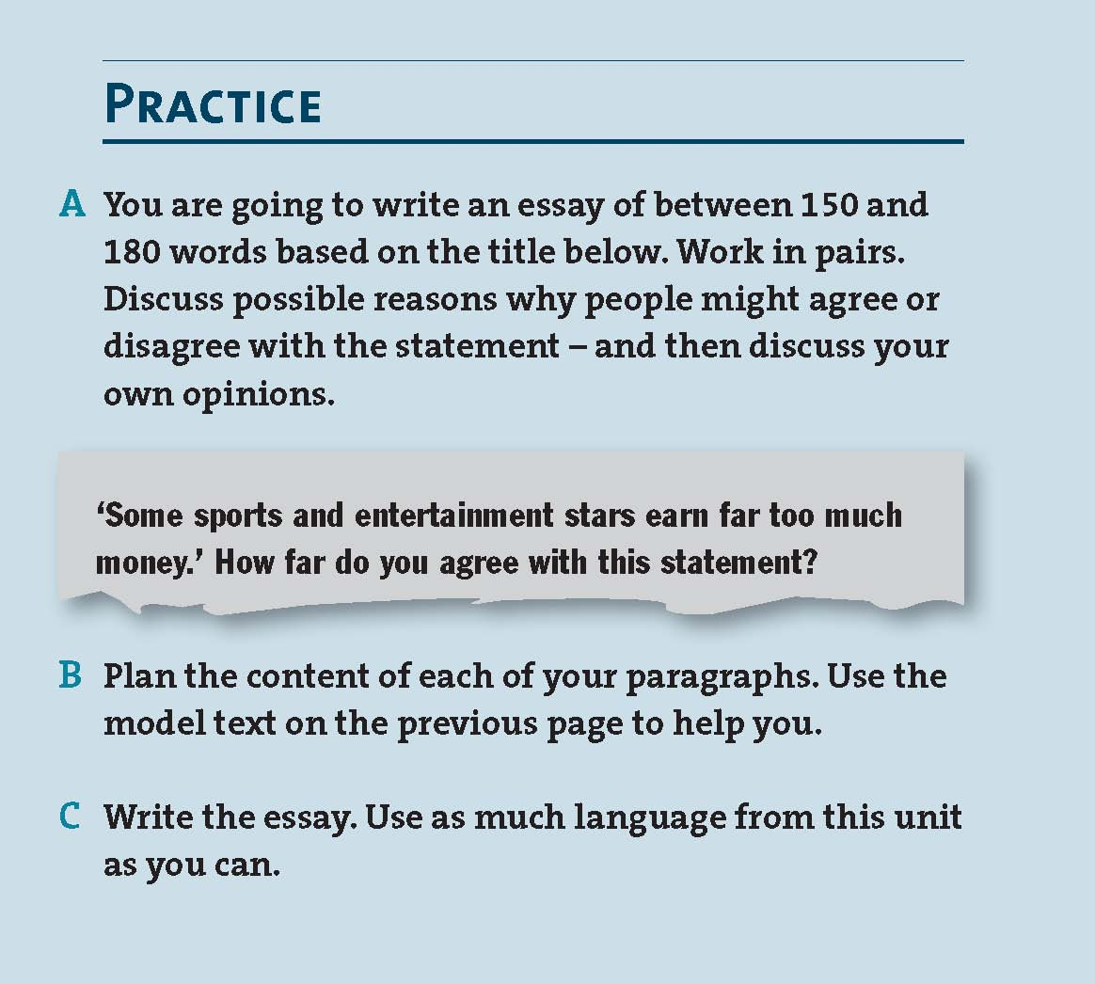
A B2 / Upper Intermediate discursive essay
Notes:
Slide 9: Just the PRACTICE section from OUTCOMES INTERMEDIATE Writing 07 For & Against, the last one-third of the right-hand column on page 133.

Slide 226
A discursive essay
Work in groups
What do you think the special features of a piece of
writing like this will be? Think about:
– the structure and the content of each paragraph
– how you’d expect the argument to be structured
– any particular lexis you’d expect to appear in the text
– any particular grammar you’d expect to appear
– any particular key words you’d expect to appear

Slide 227
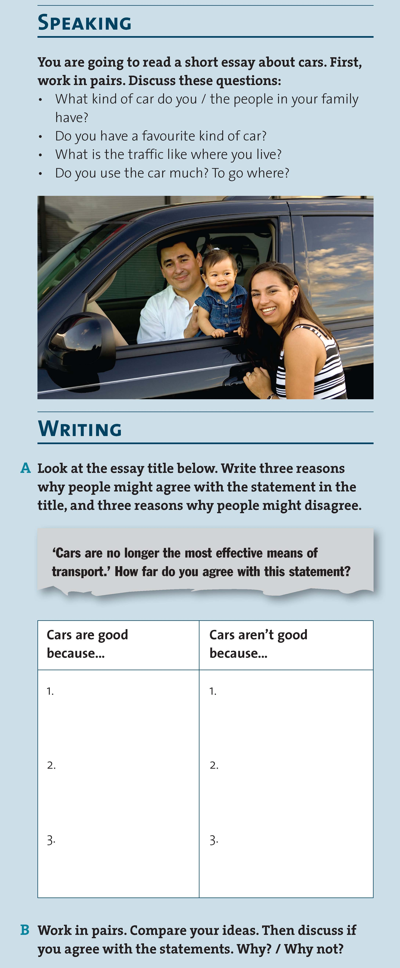
Notes:
Slide 10: The left-hand column of page 132 - the SPEAKING and the WRITING A and B.

Slide 228
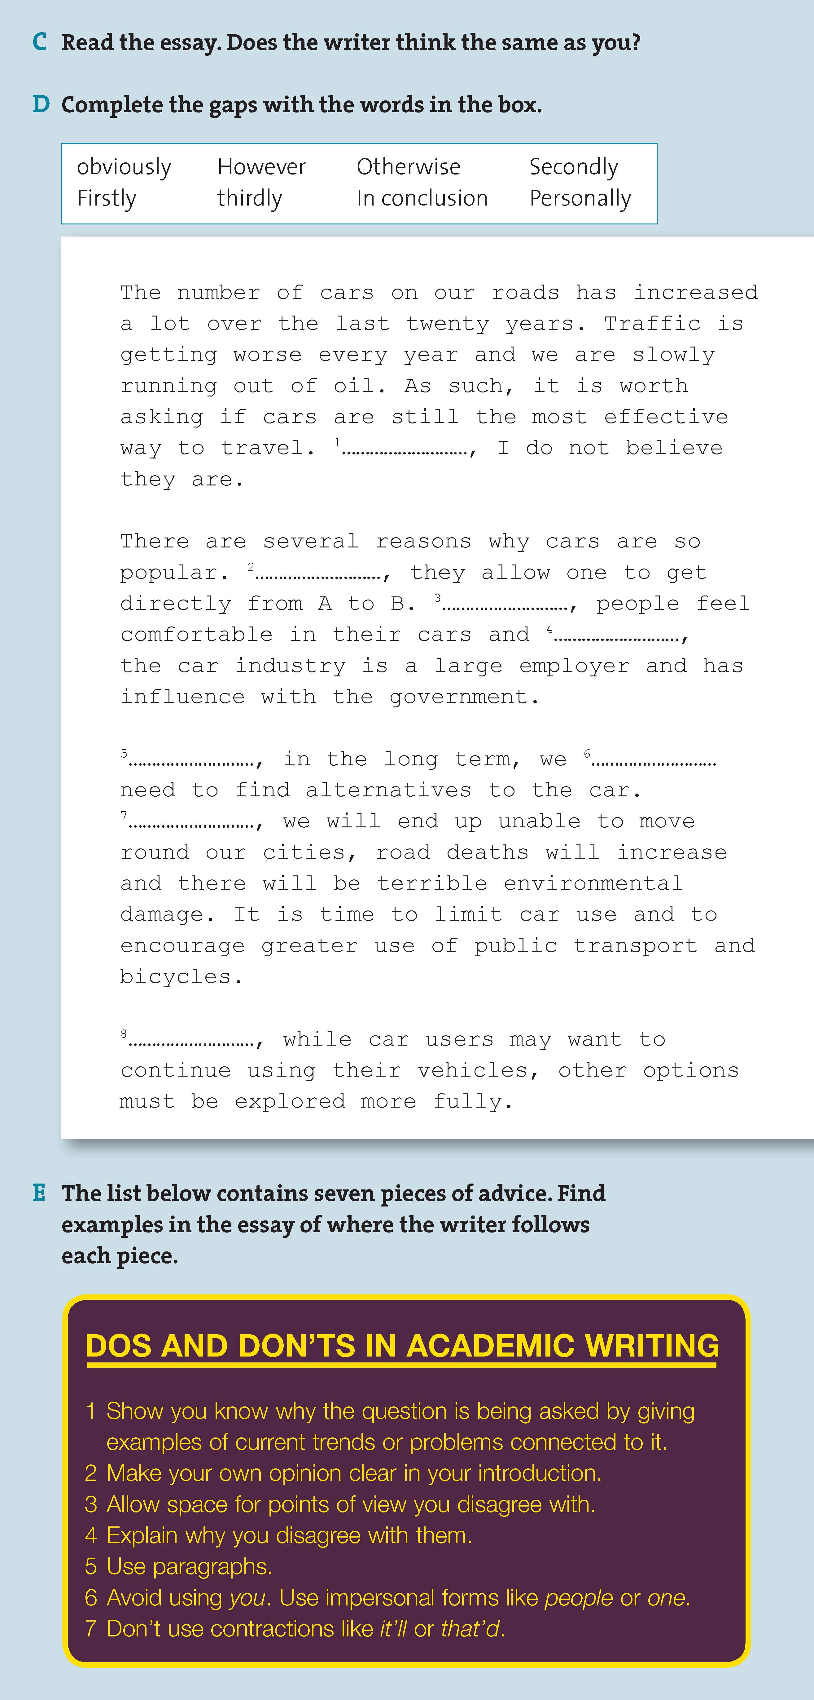
Notes:
Slide 11: The right-hand column of page 132 - exercises C, D and E, including the model text and the DO'S AND DON'TS box.

Slide 229
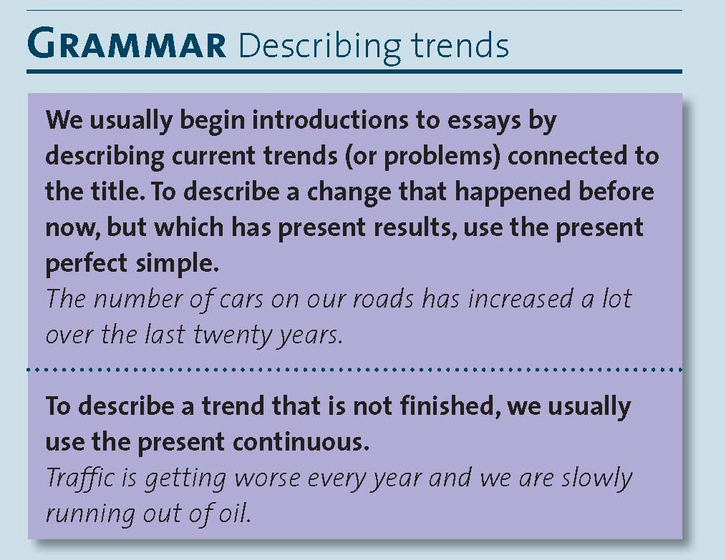
Notes:
Slide 12: The grammar column on page 133

Slide 230
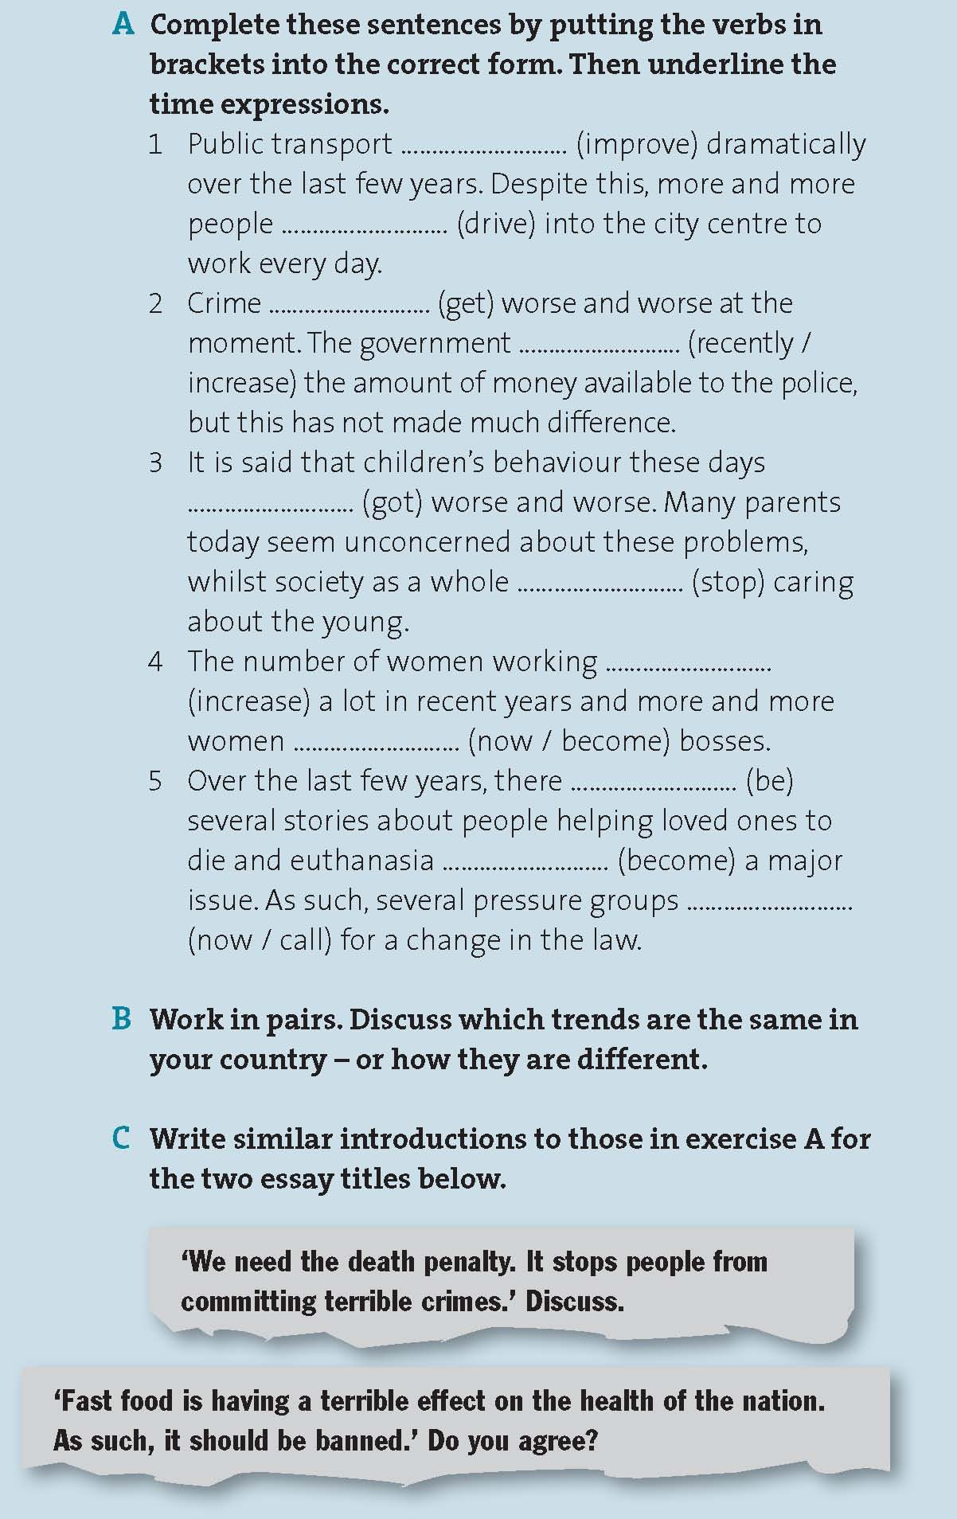

Slide 232
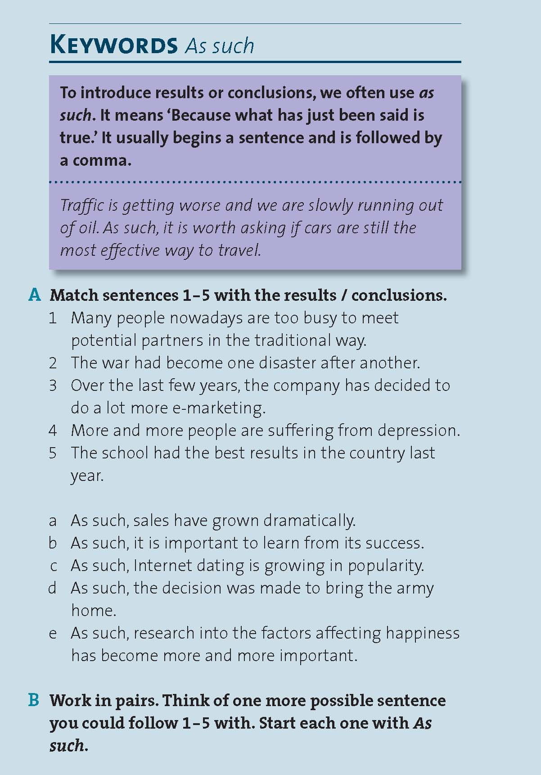
Notes:
Slide 13: The KEYWORDS section from the right-hand column of page 133.

Slide 233
Notes:
Slide 14: Just the PRACTICE section from OUTCOMES INTERMEDIATE Writing 07 For & Against, the last one-third of the right-hand column on page 133 - again.

Slide 234
Part 3: Marking and Feedback
Correct the piece of writing as you normally would.

Slide 235
Summative and formative feedback
Correcting genre texts
The importance of clear criteria
Exam markers can evaluate texts very quickly because they know
what makes a text good or not.
Criteria can reinforce aspects of the genre / teaching and help
development
Criteria can be used for self assessment and peer discussion
(no marking!)

Slide 236
Generalised criteria
FCE criteria
To get a 5:
Full realisation of the task set.
• All content points included with appropriate expansion.
• Wide range of structure and vocabulary within the task set.
• Minimal errors, perhaps due to ambition; well-developed control of
language.
• Ideas effectively organised, with a variety of linking devices.
• Register and format consistently appropriate to purpose and audience.
Fully achieves the desired effect on the target reader.

Slide 237
PET / B1
5 • Very good attempt at the task.
• No effort is required of the reader.
• All elements of the message are fully communicated.
4 • Good attempt at the task.
• Minimal effort is required of the reader.
• All elements of the message are communicated.
3 • Satisfactory attempt at the task.
• Some effort is required of the reader.
• All elements of the message are communicated. OR One content element omitted but others clearly communicated.
2 • Inadequate attempt at the task.
• Significant effort may be required of the reader.
• Content elements omitted, or unsuccessfully dealt with, so the message is only partly communicated.
1 • Poor attempt at the task.
• Excessive effort is required of the reader.
• Very little of the message is communicated.

Slide 238
Decide how you might plan a lesson around one of the models:
- speaking tasks and reading tasks
- chunk focus
- vocab focus
- grammar focus
- linking word focus
- practice task and process writing

Slide 239
Genre specific criteria
Write criteria for a short story beginning “It was three in the
morning when the phone rang".
The students have reached B1 and working towards B2.
- Think about what makes a good story, how it's structured etc.
What would get a student 8-10 / 5-7 / 2-4 / 0-1?
What might be the examples of language you would see?

Slide 240
Using criteria for feedback
It was three in the morning when the phone rang. It was my best friend Lorena, and she told me she needs help because her car was broken. Immediately, I dress up and I get my car quickly, and I went to see her. When I arrived there she was crying, she had an accident and smashed the windscreen She was really worried because the was her father's car. we didn't know what to do, so we decided to call a friend. Ten minutes later the police appears and we called my friend's parent and we explained to them all. We though that her father would be really furious, but he was really calmed, and he understand everything. They stay there, and I went home at 5 o'clock.

Slide 241
Formative feedback and criteria
Share your criteria with students. Show them what it is you are looking for even if it is given verbally and shows what will get the top mark or pass.
When marking, read the student’s work as a whole piece of writing first – before the red pen comes out
Think about the degree to which it meets your criteria. If it fails to, consider how / why.
3 In terms of genre writing, the initial feedback should be based on your criteria what’s good and two or three points on how to improve. You may not have time or want to correct specifics of language AT ALL!
4 ASK THEM TO REWRITE IT. Check they have understood your point.

Slide 242
Is there anything you would change in your feedback or mark based on this section?

Slide 243
Approaches to correcting specific language
The tension between self-correction & reformulation
SYMBOLS
t = wrong tense
wf = wrong word form (e.g. noun not adjective)
col = wrong collocation (e.g. the noun is the right meaning but doesn't go with the verb)
voc = you have the wrong word (it makes no sense here)
prep = you need a different preposition
pl = plural is wrong or should be plural
sp = wrong spelling
wo = the word order is wrong
art = the article is wrong or absent
Rewrite & compare

Slide 244
Approaches to correcting specific language
Look at the piece of writing corrected like this
Discuss the pros and cons of this approach
So how else might things be done?

Slide 245
Approaches to correcting specific language
Look at the piece after far more errors have been corrected
and feedback has been given.
Discuss the pros and cons of this approach
What’s still missing?

Slide 246
Approaches to correcting specific language
The advantages of writing your own models
You develop a greater awareness of how texts work
Over time, you build up a bank of model answers
Students see their own ideas phrased in a more sophisticated manner
They get exposed to alternative grammar and chunks
The downsides?

Slide 247
Alternatives to correction
Time is short and our lives are busy, so . . .
RESPOND IN PERSONAL WAYS – INSTEAD OF CORRECTING
- comment and share experiences
- ask questions
SET LIMITS
- explain before that you will correct three / four / five things
- only correct one aspect (tense / prepositions / collocation, etc.)
- only correct / question where you don't understand
NO CORRECTION!
- use the homework as the basis for class exercises
- (with younger kids) have a reward scheme for doing something
Remember: all learners for all language go through a process of experimenting and getting things wrong whether we correct or not!

Slide 248
Part 4 and 5
Preparing students for exams
Practice Genre Writing lesson
REQUEST

Slide 249
Am I just an old hippy?

Slide 250
Some ways to correct ‘communicative students’
I’m going to Paris for the weekend.
I’m off to paris for the weekend
It’s alright for some!
So did you learn how to fly the planes?
You’re joking! We just cleaned the floors.
You must be joking! The nearest we got to flying the planes was cleaning the hangar floors!

Slide 251
The backwash of bad exams
The flight ............... at 10 o’clock tomorrow.
A is leaving B leaves
C will leave D is about to leave

Slide 252
Some other things which are a bad sign
The government is / are
There are less / fewer cars
Would you like some / any tea?
Reported speech
Must and have to
Tense!

Slide 253
The memory and myth of exams
Use of English
- passive transformations and dramatic inversions
Reading, Writing, Speaking and Listening
- Skills

Slide 254
Some conclusions on Use of English
The meaning of tense is not tested!
Some tense forms are tested but probably add up to about 5% of 20% of the exam.
Most of the focus is not ‘grammar’ but the grammar of words.
We need to constantly present vocab in chunks as it is used and get students to manipulate and work those chunks.

Slide 255
Some conclusions on skills
You need to teach a lot of lexis and that doesn’t mean single words.
In class, constantly ask questions about language to generate language.
We don’t normally read like we do in an exam and there is no right way to do it.
Skills don’t work and won’t help - language will!
Most listenings are quite natural and often colloquial, so don’t ignore such language.
Students need lots of models of writing but authentic models of writing are not authentic to the writing exam.

Slide 256
Part 5: Any Questions?

